Slide 1
Java Virtual Threads
A new feature introduced with Java 19

Slide 2
Before get started:
To understand virtual threads we have some preconditions
Operating System
Process
Thread
JVM

Slide 3
What is Operating System?
An operating system (OS) is an essential piece of software that serves as an interface between computers and users. The OS manages hardware, software, and processes. It is responsible for executing programs, allocating resources, and performing many other tasks essential for the functioning of a computer system. Linux Kernel, Microsoft Windows, macOS, and Android are some of the most common operating systems.

Slide 4
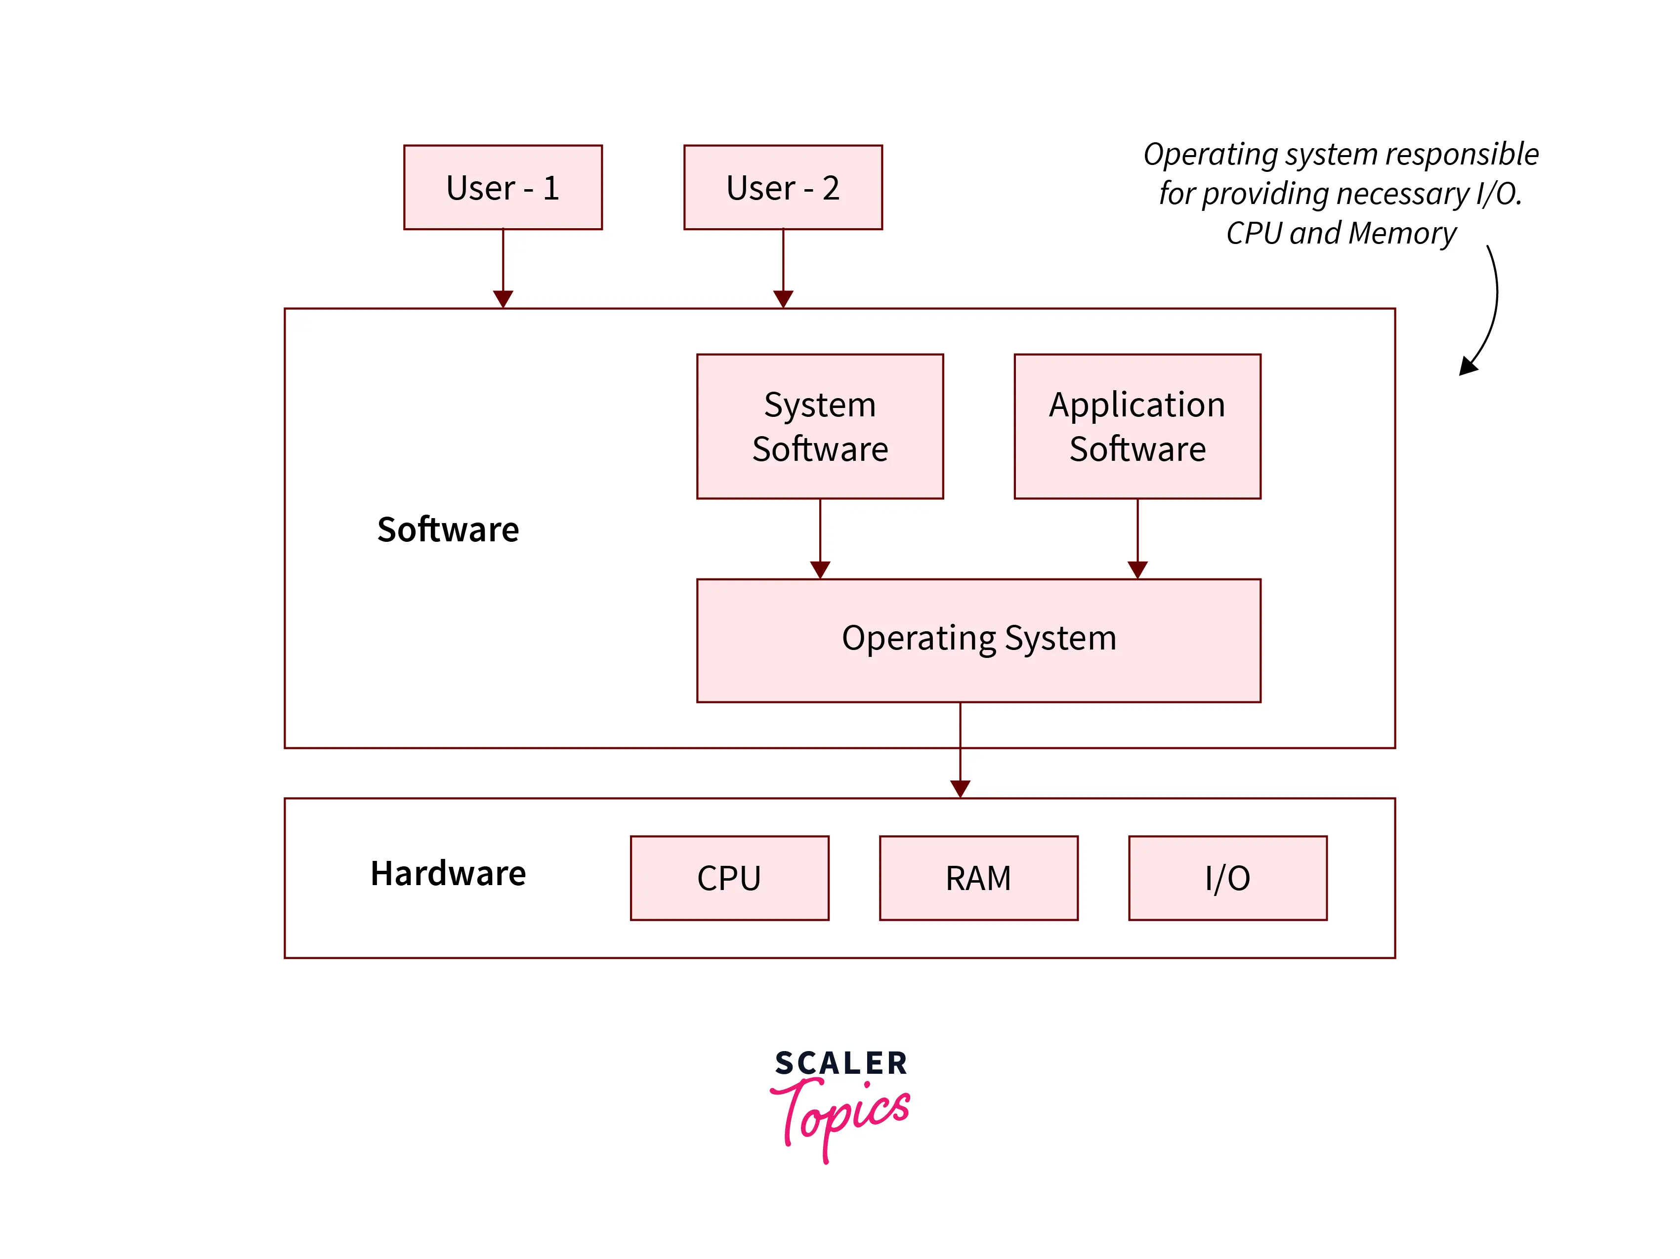
Architecture of Operating System (OS)

Slide 5
Are device drivers part of the OS?
What is driver?
A driver is a component of an operating system and has privileges to access devices directly via the BUS (communication system). Drivers manage data access and allocations for devices. Their ability to access devices directly via the BUS does make them an integral part of the operating system.

Slide 6
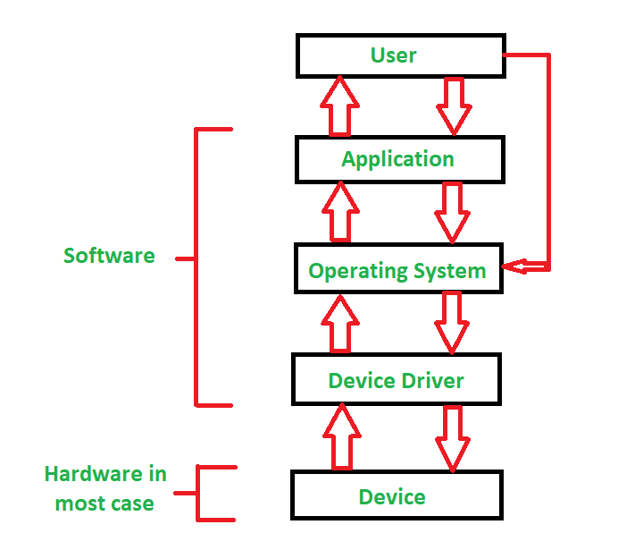
Architecture of Drivers

Slide 7
What is Process?
The brief definition of a process is a program executor that is loaded into memory. To be more specific, when you build and execute a C/C++ or Java program, you load your program into memory, and the CPU (Central Processing Unit) handles it. The process consists of text, stack, heap, and data sections in memory, each of which is managed by the process during runtime.

Slide 8
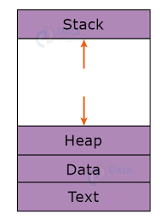
How does process seen in the memory?

Slide 9
Explanation of Process
Stack:
Stores temporary information like function, arguments, local and static variables.
Heap:
This is a dynamic memory field. According to requirements of the process can be expand.
Text:
Represents activity and information of program counter.
Data:
Contains global and static variables.

Slide 10
What is Thread?
A thread is a single sequential flow of execution within a process. It is often referred to as a lightweight process because it shares resources such as memory and files with other threads within the same process. A process can have multiple threads, and threads within a process can run concurrently, either in parallel or sequentially.
Threads share the same memory space within a process, allowing them to access and modify the same data. This shared memory makes communication between threads easier but also requires careful synchronization to avoid data corruption or race conditions.

Slide 11
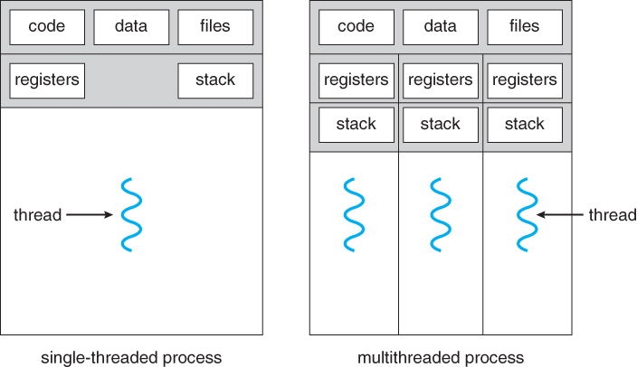
How is a thread viewed in relation to a process?

Slide 12
What is Java Virtual Machine (JVM)
The JVM (Java Virtual Machine) is a program running on an operating system (OS). The JVM architecture is developed to enable platform independence for running Java programs. Java bytecode, compiled from Java source code, is executed by the JVM, abstracting away the differences between various operating systems. Unlike C code, which compiles to machine code specific to each platform, Java bytecode remains consistent across platforms.
In contrast to languages like C and C++, where the compiler produces machine code directly executable by the CPU, Java relies on the JVM to execute bytecode. The JVM handles memory management, process control, and other system-level tasks, shielding the Java program from the underlying hardware and OS specifics.
Regarding thread management, the JVM employs a thread pool to efficiently manage threads. This approach minimizes the overhead associated with reaching the kernel and performing context switches.

Slide 13
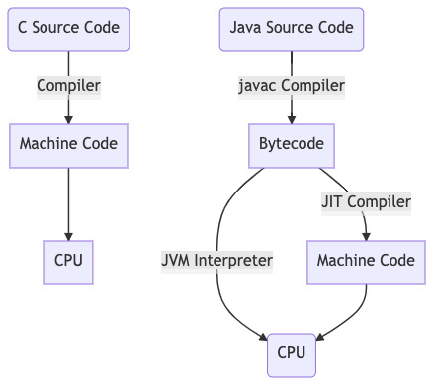
The lifecycle of Java code differs from that of C code.

Slide 14
Why does Java need Virtual Threads?
So far, we've briefly explained what a thread is and how it works in Java. In Java, there's a thread pool at the JVM level, and these threads are managed directly by the OS at the kernel level. Creating new threads comes with a runtime cost. To mitigate this, the JVM maintains a thread pool. However, there are occasions when the available threads are insufficient.
Virtual threads, managed and scheduled by the JVM, address this issue. Unlike traditional threads, virtual threads do not incur system calls.

Slide 15
Pros and Cons
Enhances application accessibility.
Mitigates OutOfMemoryError occurrences.
Decreases application memory consumption.
Eliminates the need for system calls for allocation and context switching.
Eliminates the necessity for a thread pool.
Offers inexpensive start/stop operations.
May face limitations in mathematical computing scenarios due to potential resource insufficiency.

Slide 16
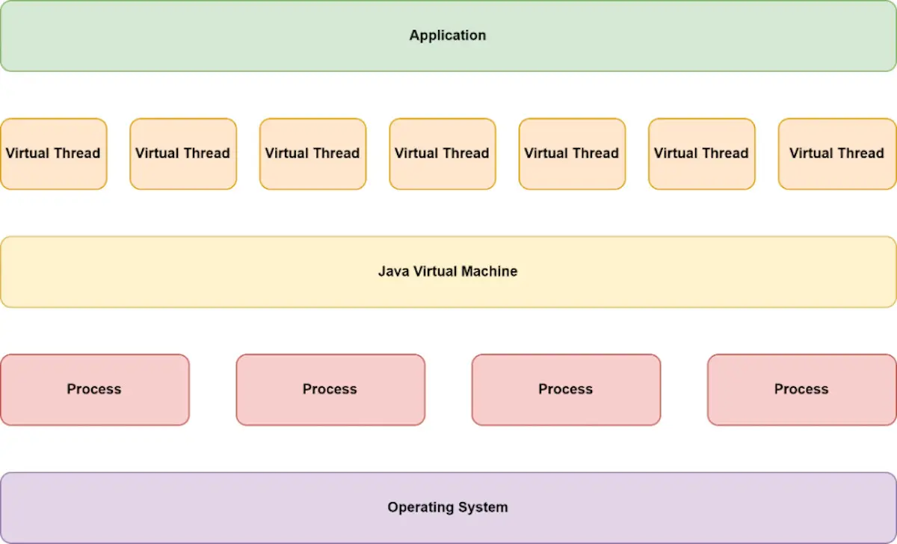
Java Virtual Thread Architecture

Slide 17
How to use in Spring Boot?
Spring Boot 3.2 supports virtual threads.
spring.threads.virtual.enabled=true by adding given config it’s enabled
JDK version must be 21>=

Slide 18
References
https://www.geeksforgeeks.org/what-is-an-operating-system/
https://www.javatpoint.com/operating-system
https://www.tutorialspoint.com/operating_system/os_overview.htm
https://www.spiceworks.com/tech/devops/articles/what-is-device-driver/#:~:text=Device%20drivers%20operate%20inside%20the,for%20which%20they%20were%20developed.
https://superuser.com/questions/447048/are-drivers-part-of-the-operating-systems
https://www.tutorialspoint.com/operating_system/os_processes.htm
https://www.javatpoint.com/what-is-the-process-in-operating-system
https://www.geeksforgeeks.org/introduction-of-process-management/
https://byjus.com/gate/process-in-operating-system-notes/
https://byjus.com/gate/what-is-thread-in-operating-system-notes/#:~:text=Benefits%20of%20Threads-,What%20is%20Thread%20in%20Operating%20Systems%3F,process%20can%20have%20several%20threads.
https://www.geeksforgeeks.org/thread-in-operating-system/
https://www.javatpoint.com/threads-in-operating-system
https://www.cs.uic.edu/~jbell/CourseNotes/OperatingSystems/4_Threads.html
https://www.javatpoint.com/jvm-java-virtual-machine
https://www.geeksforgeeks.org/jvm-works-jvm-architecture/
https://www.lenovo.com/us/en/glossary/jvm/?orgRef=https%253A%252F%252Fwww.google.com%252F
https://www.developer.com/java/java-virtual-machine/
https://www.guru99.com/java-virtual-machine-jvm.html
https://www.infoworld.com/article/3678148/intro-to-virtual-threads-a-new-approach-to-java-concurrency.html
https://medium.com/@RamLakshmanan/java-virtual-threads-easy-introduction-44d96b8270f8
https://www.baeldung.com/java-virtual-thread-vs-thread
https://medium.com/codex/java-virtual-threads-9fad6c362890
https://bell-sw.com/blog/a-guide-to-using-virtual-threads-with-spring-boot/

Slide 19
Thank you for your attention!
Feel free to reach out if you have any questions or need further clarification.
Halit Burak Yeşildal
Email: burak.yesildal@tigahealth.com
LinkedIn: https://www.linkedin.com/in/burakyesildal/
We appreciate your time and interest!

